Slide 1

AIML CA2
By: Jaysoorya Rajendran
Class: DAAA/FT/1B/01
Admin Number: P2309024

Slide 2

Part A Time Model Series

Slide 3
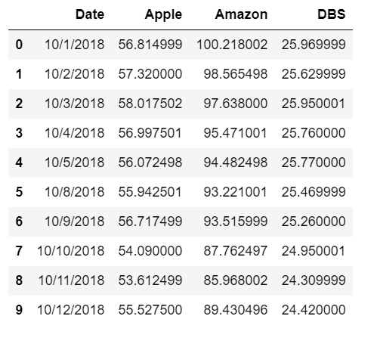
Analysing the Dataset
While studying the dataset, I found an abnormality in the dataset. I realised it didn’t contain any values for certain dates. In this case, it was missing values for the 6th and 7th

Slide 4
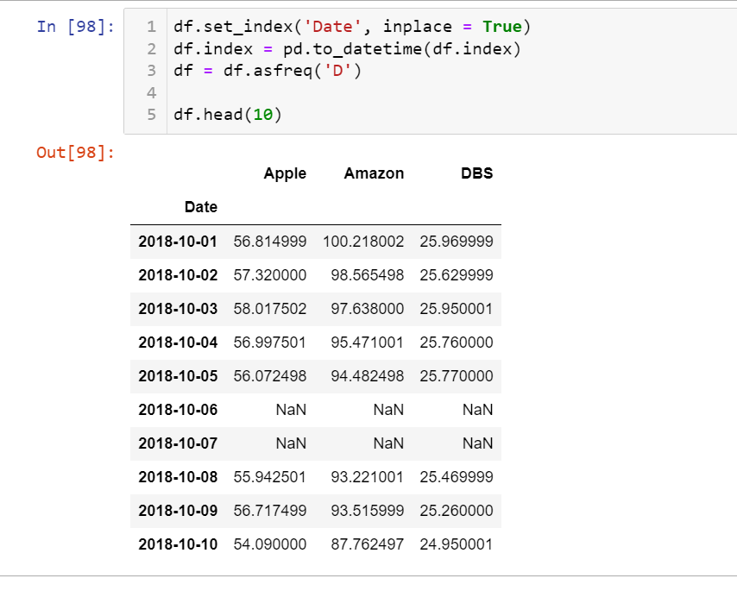
Analysing the Dataset
After doing some simple research, I realised that these dates were Saturdays and Sundays. Thus
I realised that there reason as to why the values were NaN is as the stock market closes on Saturdays and Sundays.

Slide 5
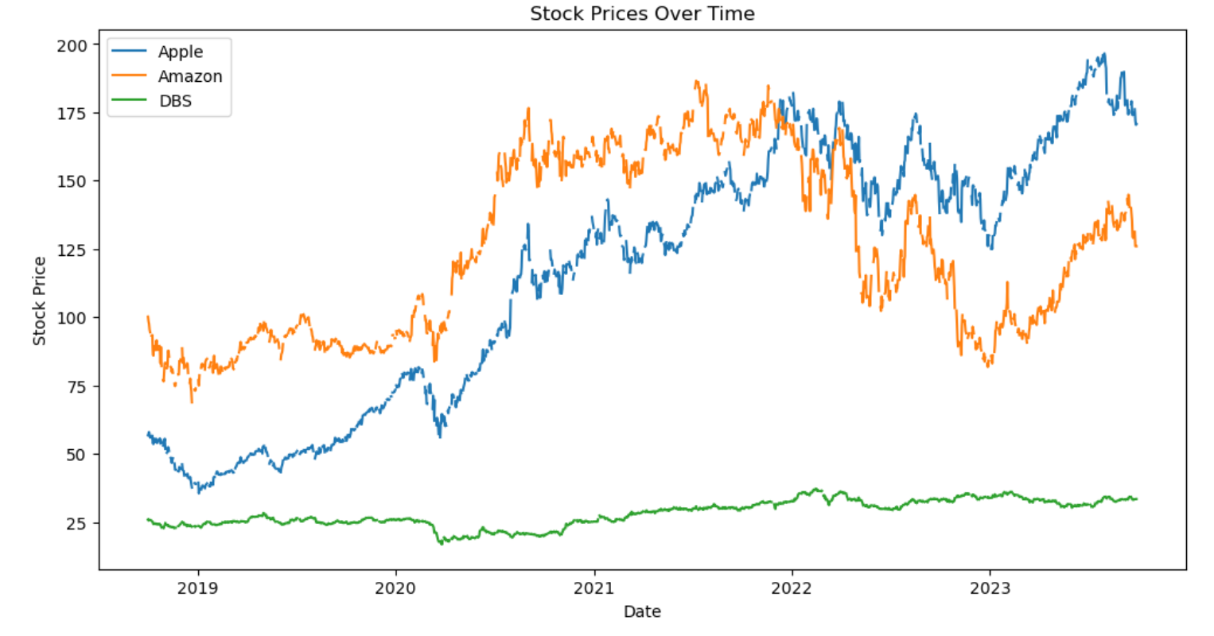
Line Chart showing Gaps in Dataset

Slide 6
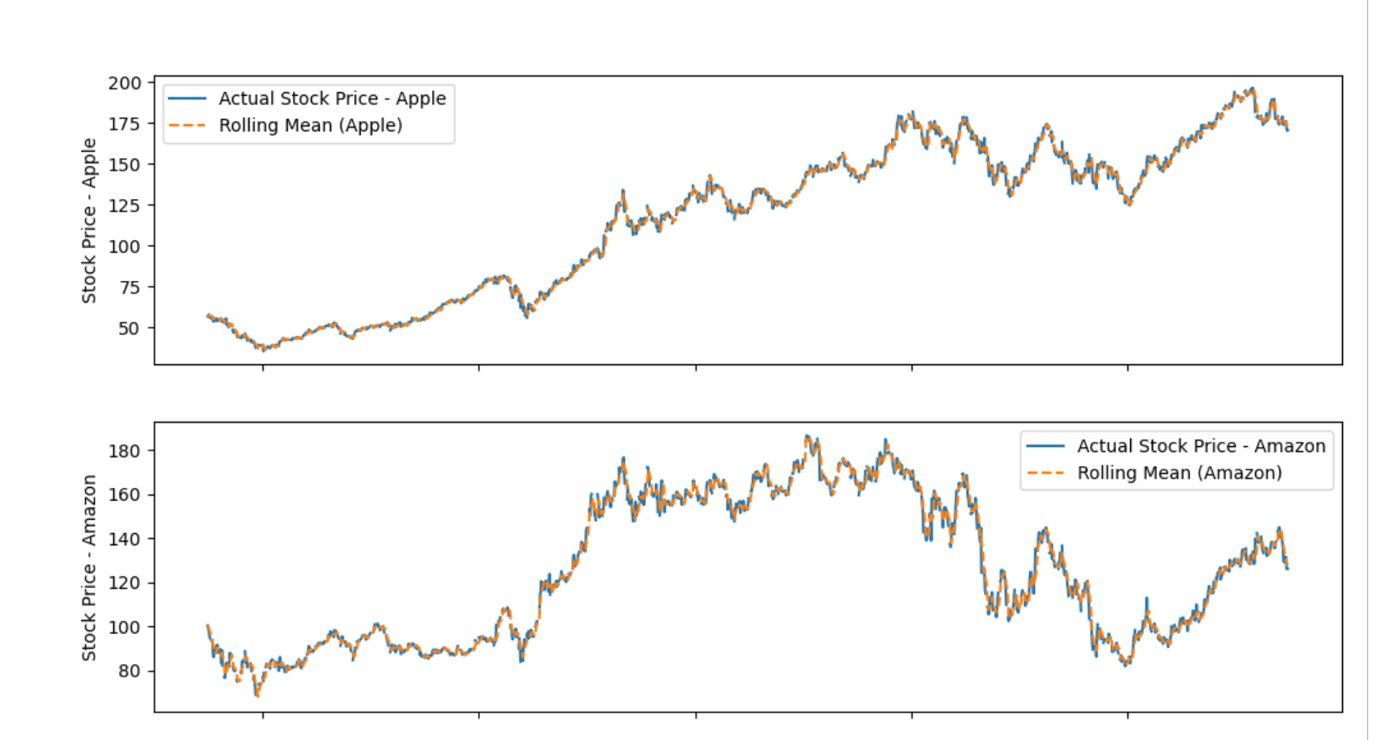
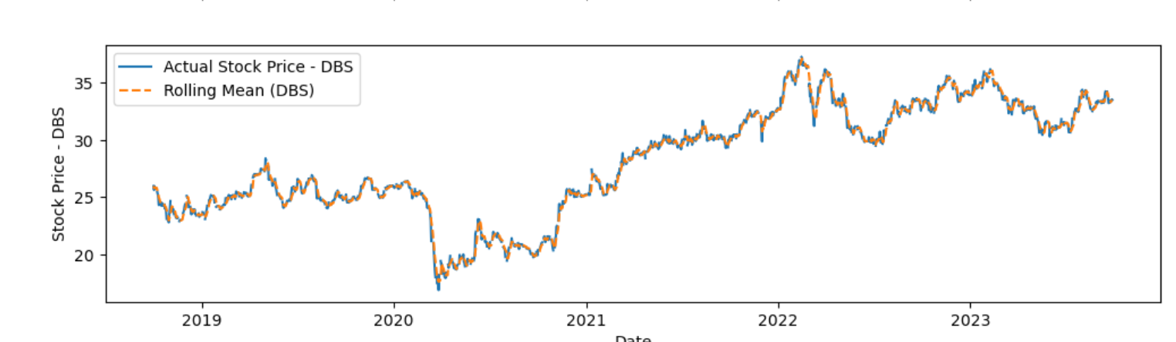
Rolling Means
To fix this, I used Rolling Means. For my rolling means, I decided to use the window value of 5 as I wanted my model to be able to use the 5 weekdays, to smoothen the data and calculate the mean based off the days and help to show the pattern of the line chart for the stocks clearer.

Slide 7
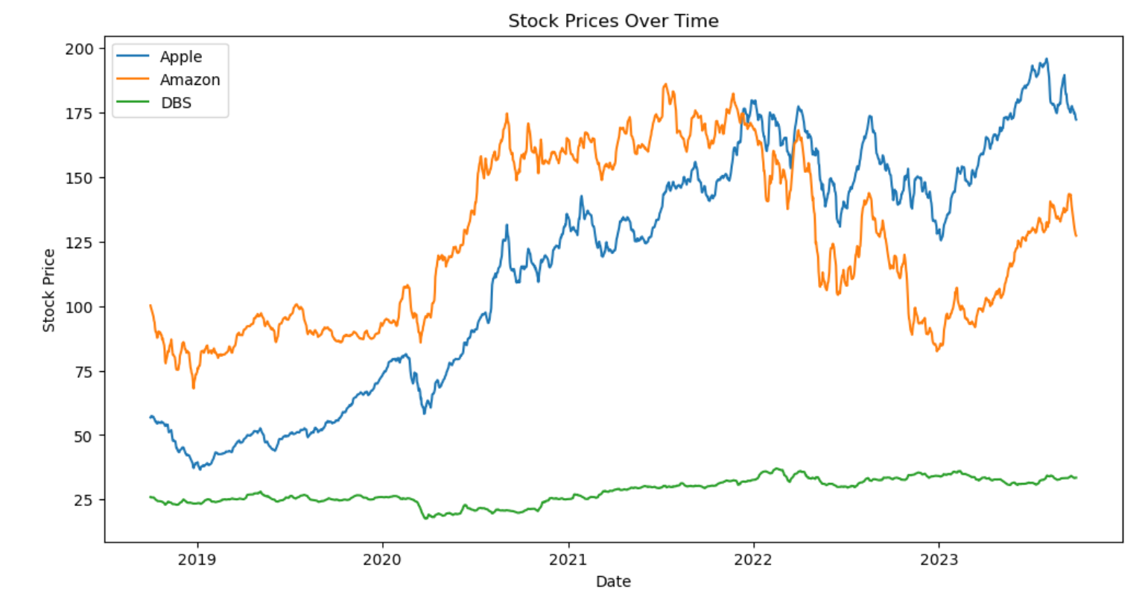
Line Chart After Rolling Means

Slide 8
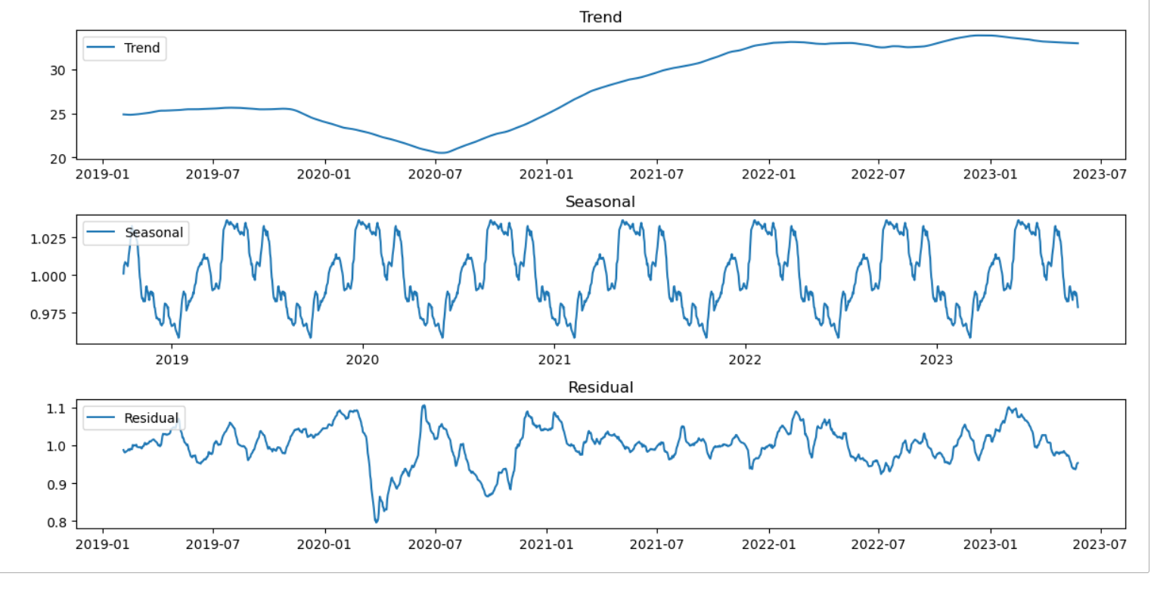
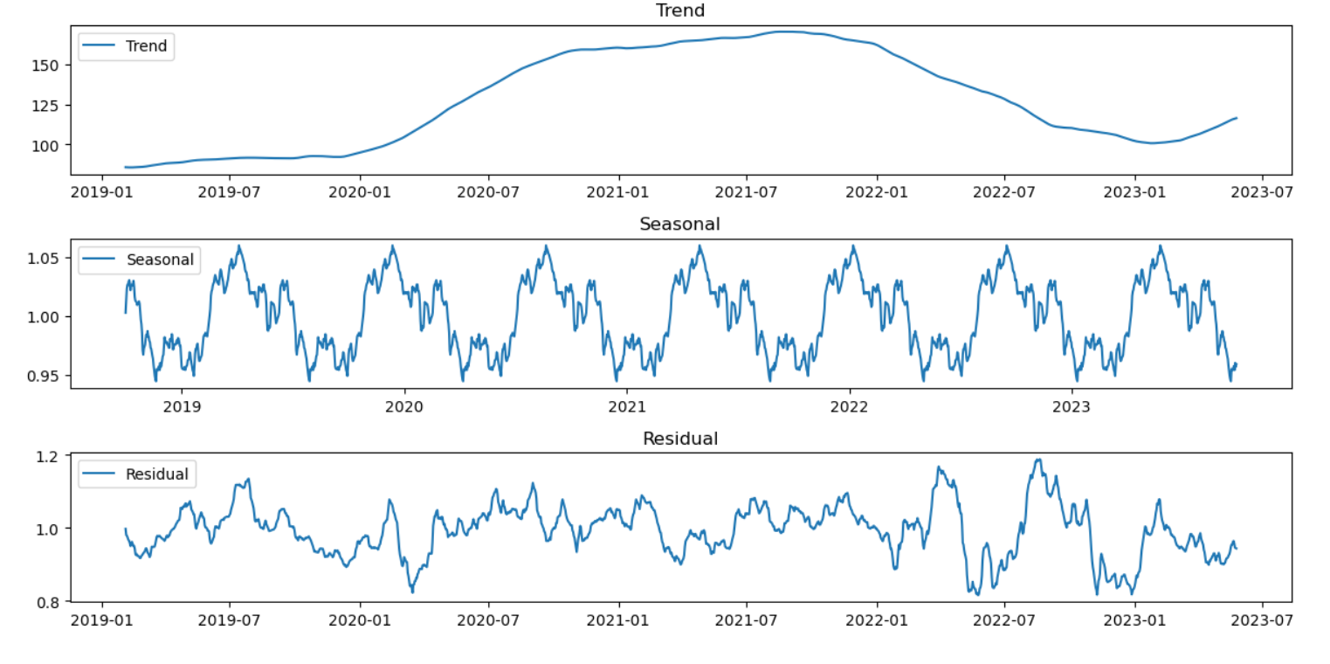
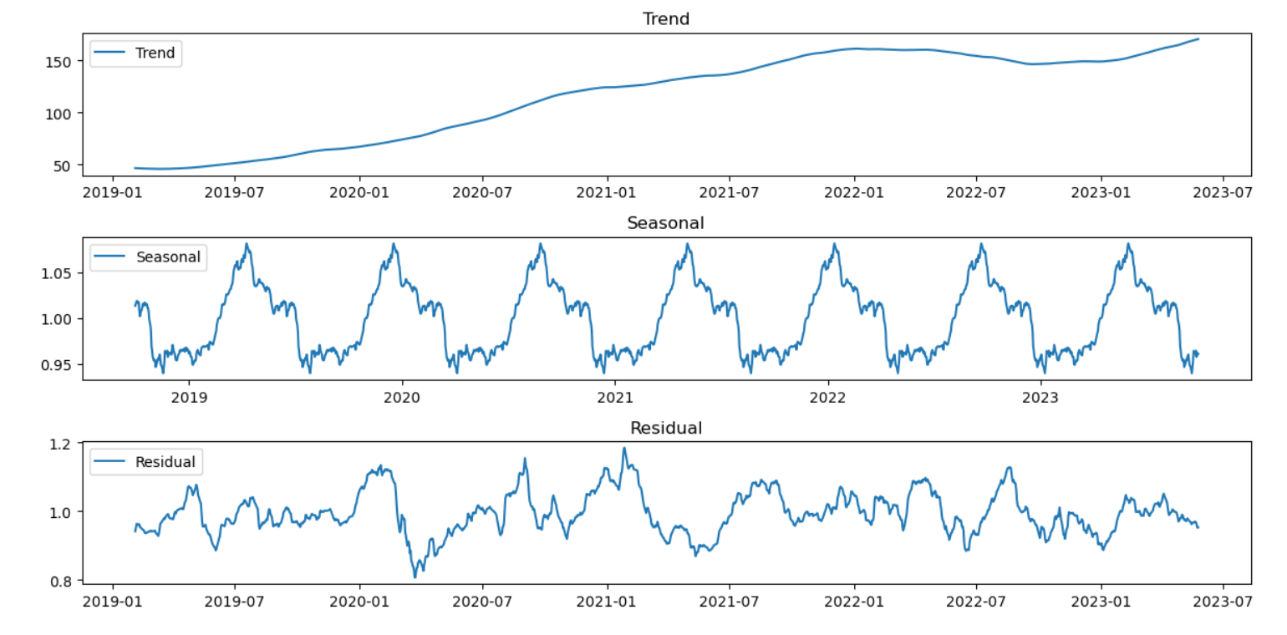
Seasonal Decomposition
I did seasonal decomposition for all the 3 stocks, Amazon, Apple and DBS, to use for my Models.
Apple
Amazon
DBS

Slide 9
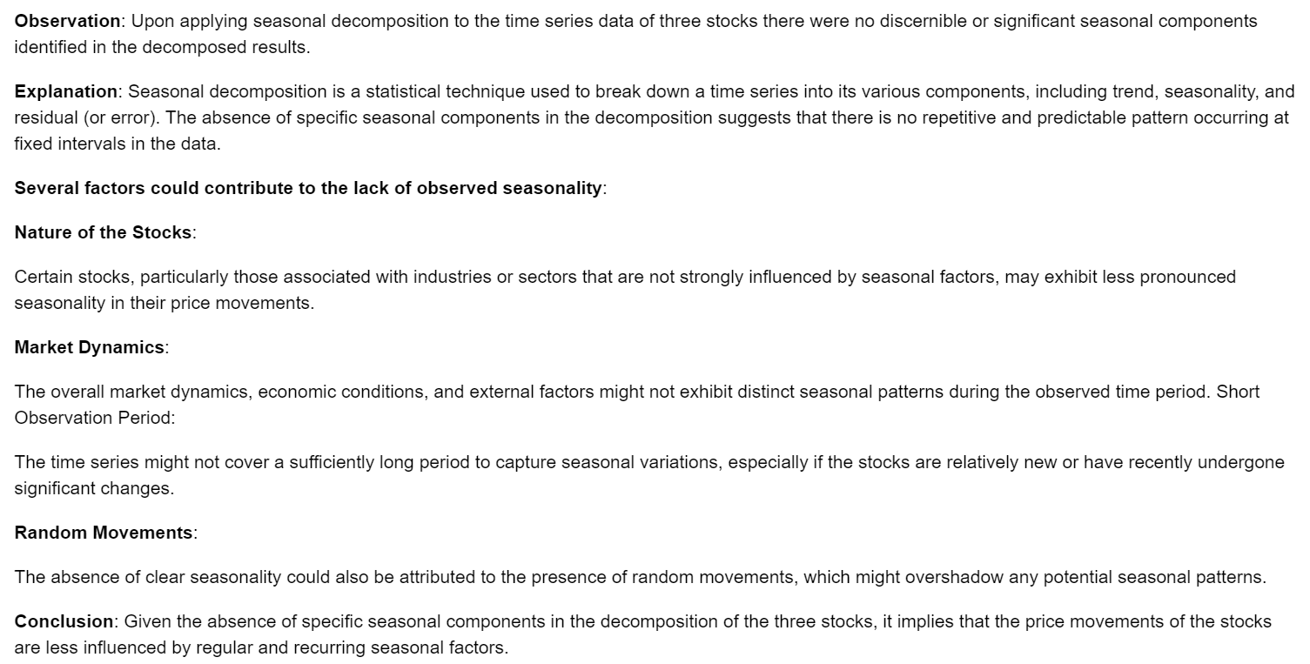
Seasonal Decomposition
From the seasonal Decomposition, I realized that no significant seasonal components were identified in the decomposed results. This was as there were no repetitive or predictable patterns occurring at fixed intervals in the dataset, which further proves that the stock prices had no distinct pattern.

Slide 10
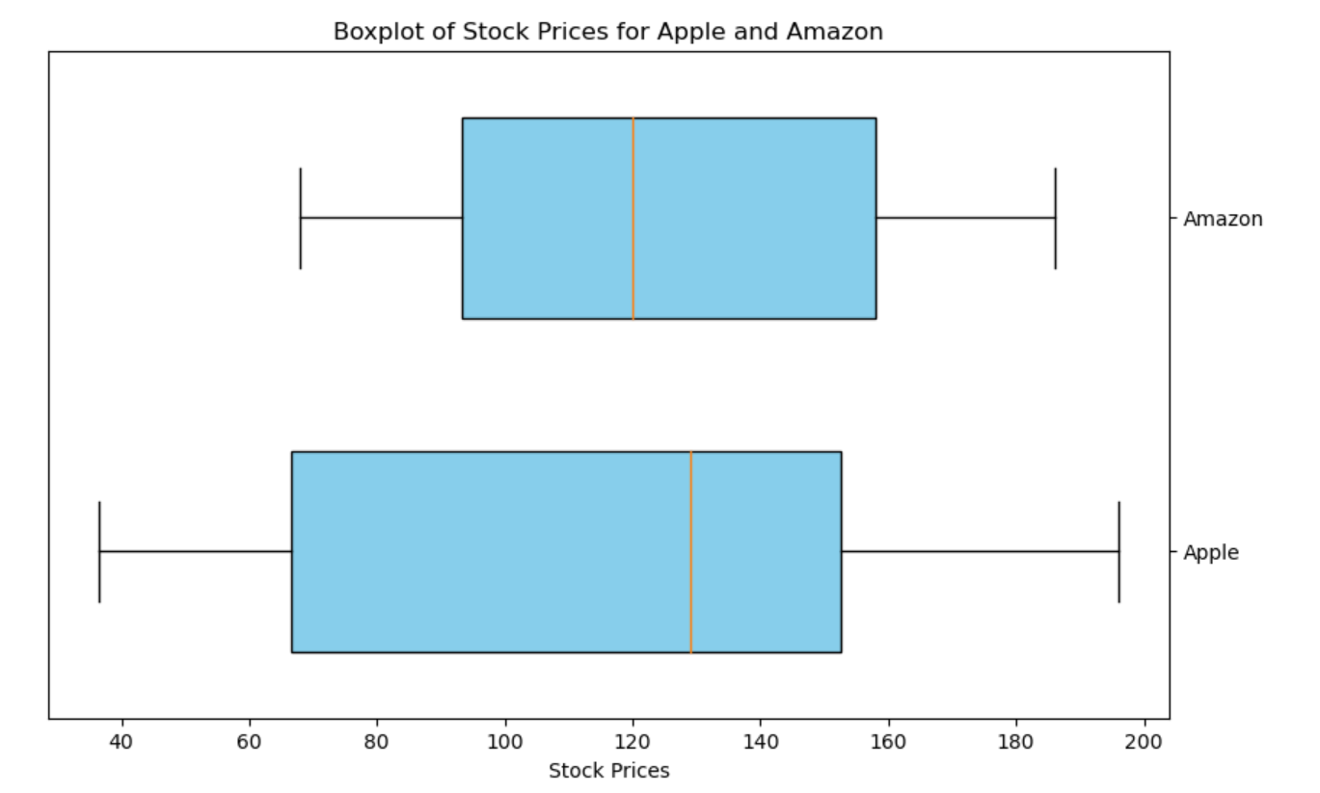
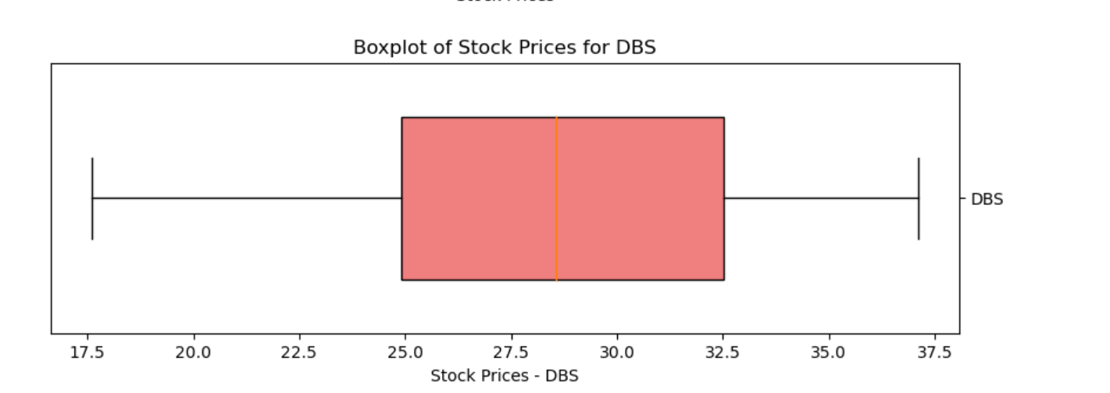
Finding Outliers
I also found no outliers in the dataset.

Slide 11
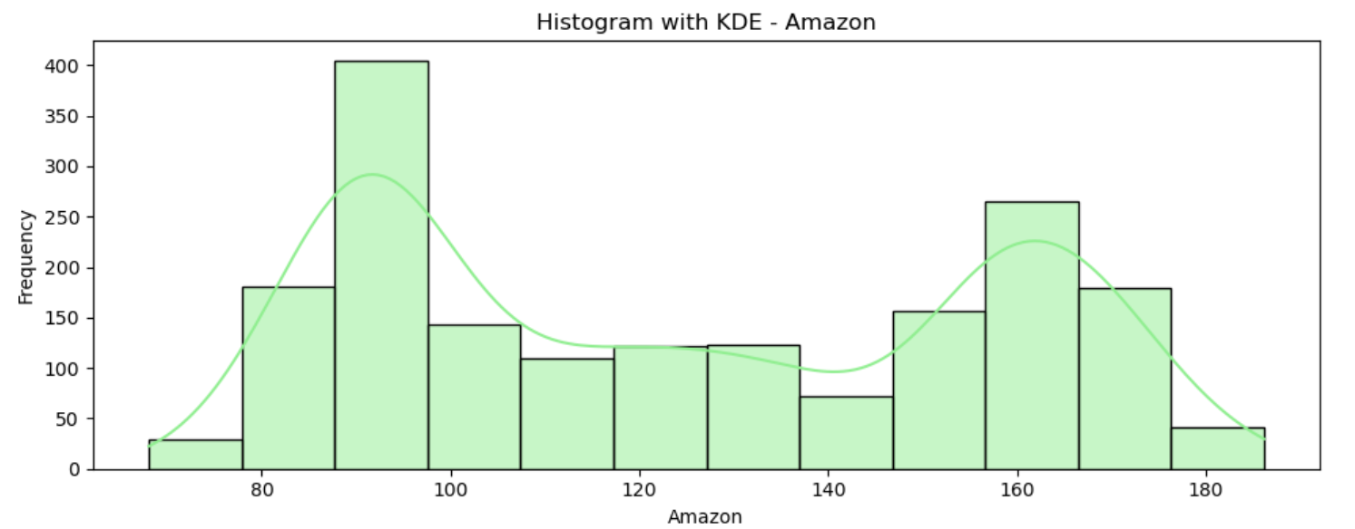
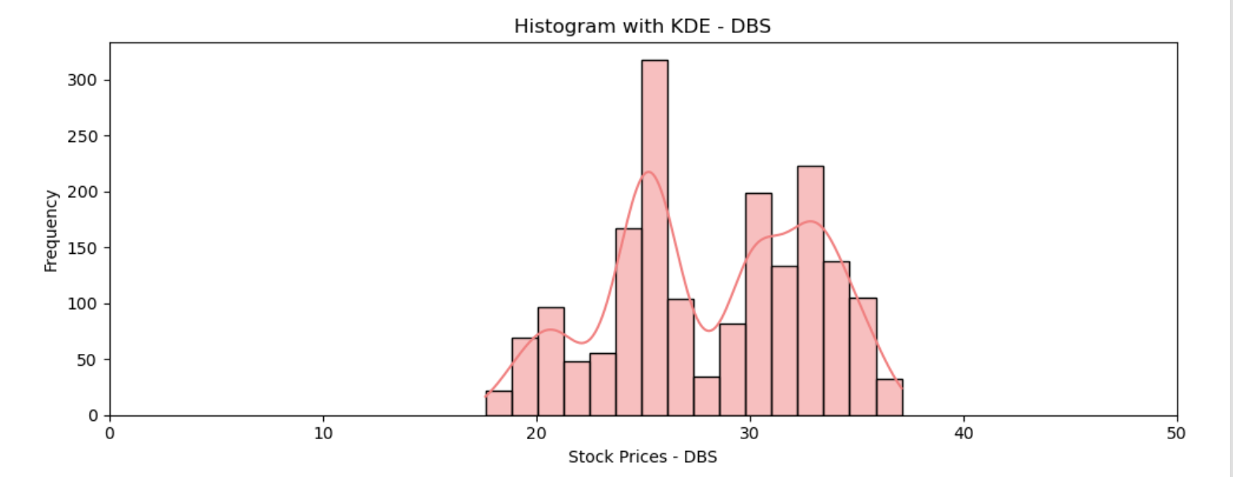
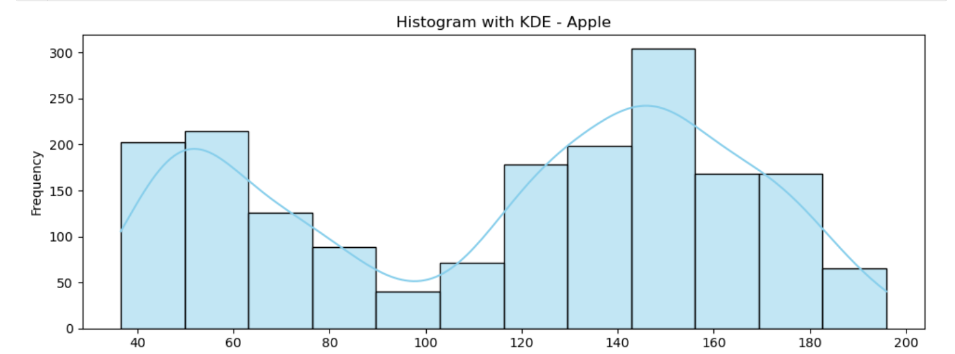
I then plotted a histogram for the 3 different stocks, and from this, it can be seen that there is no clear skewness or distribution in the prices, further showing that the stocks have no distinct pattern.

Slide 12
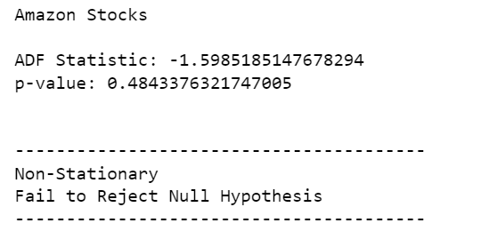
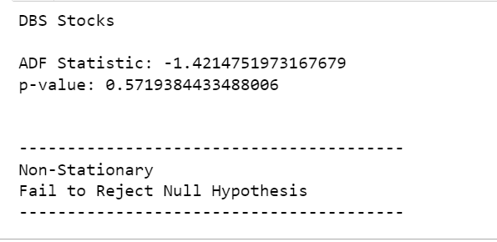
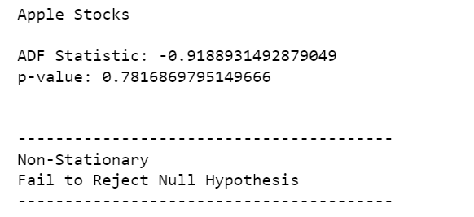
ADF Tests
I then did an ADF Test on all 3 columns, and from this I was able to determine that all the stocks contained Non-Stationary values.

Slide 13
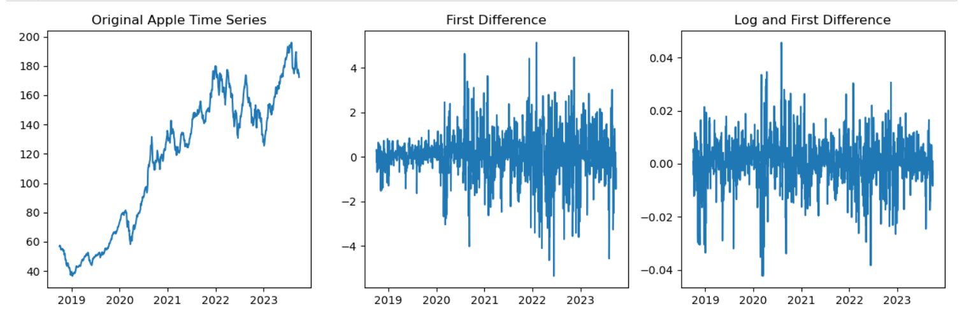
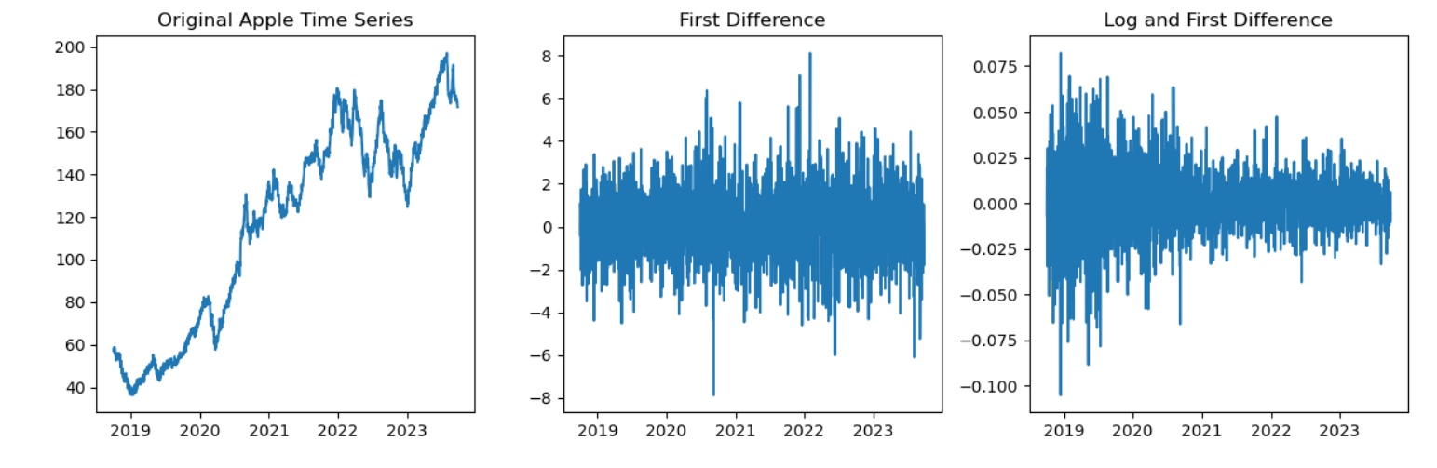
Apple Stock
I then plotted the original time series , the first difference, and the Log and First Difference. As can be seen, this is the difference in the dataset before and after adding White Noise. We can see the difference to be huge and crucial for our predictive models.
Before adding White Noise
After adding White Noise

Slide 14
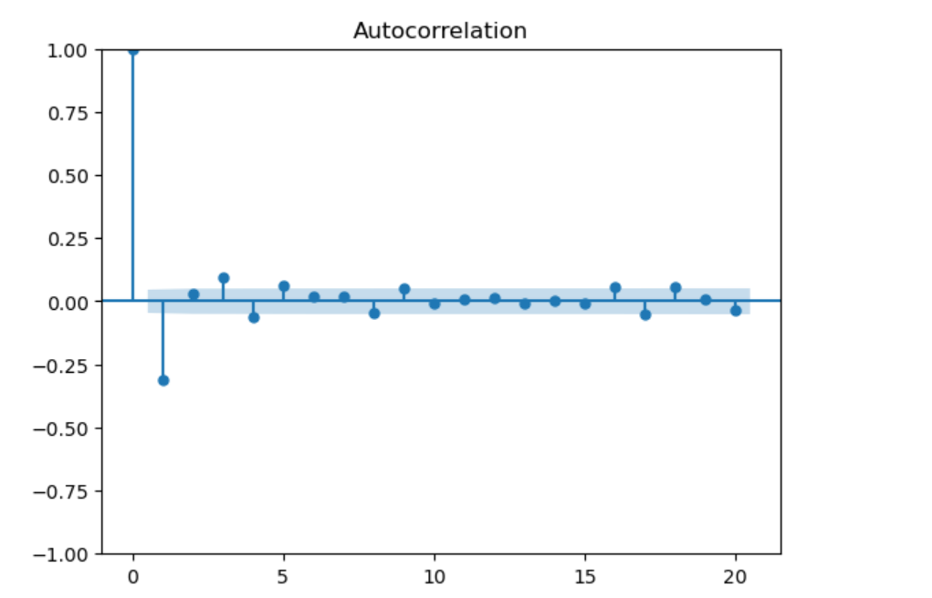
ACF Plot (Apple)
This is what the ACF plot for Apple looked like. From this, its shown that the only value for where the value is 1 is when comparing with its past self. The rest of the lags show that there is little to no correlation between the observations of the stock prices at those lags. This makes sense and the price of a stock is constantly changing and is very rarely, the same

Slide 15
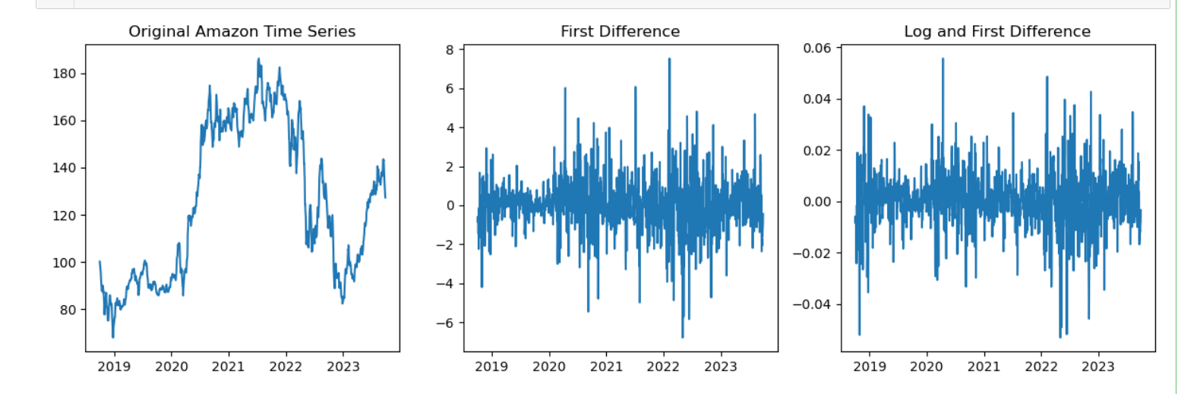
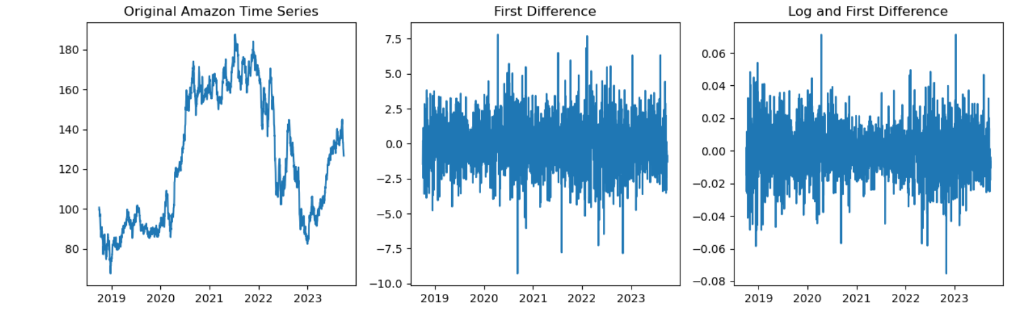
Amazon Stock
I then plotted the original time series , the first difference, and the Log and First Difference. The plot before adding White Noise shows that. As can be seen, this is the difference in the dataset before and after adding White Noise. We can see the difference to be huge as it helped to show whether the data is homoscedastic or heteroskedastic better
Before adding White Noise
After adding White Noise

Slide 16
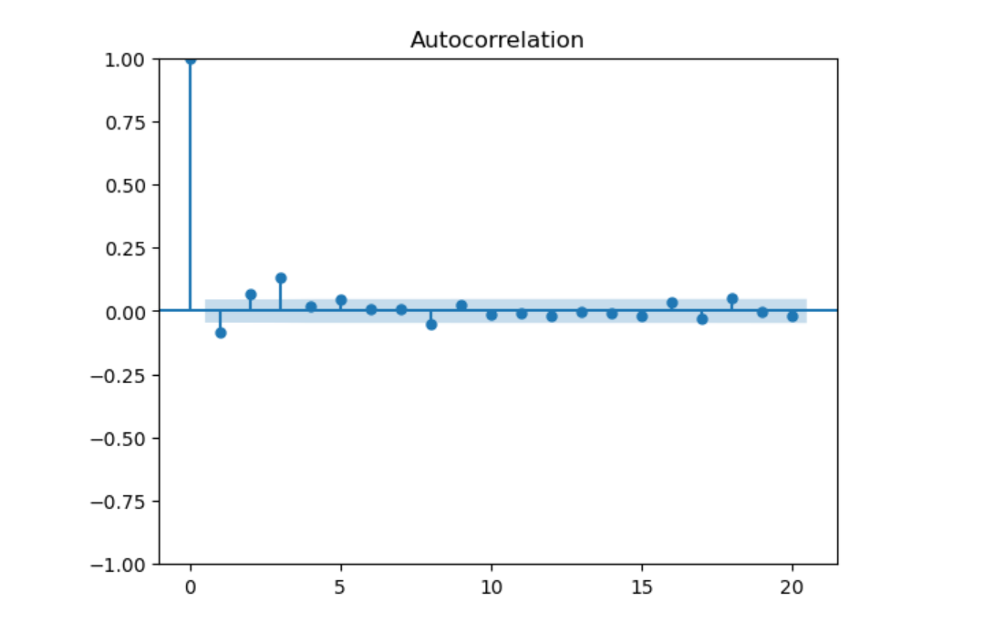
ACF Plot (Amazon)
From this, we can also see that there is only a strong correlation when comparing to its past self, while the rest of the lags show very little to no correlation. Thus this further proves that the stock prices cannot be compared to the rest as they vary much from each other.

Slide 17
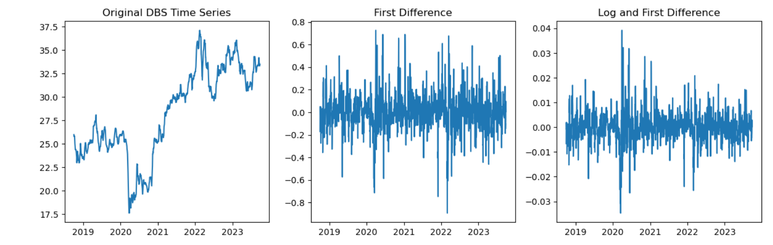
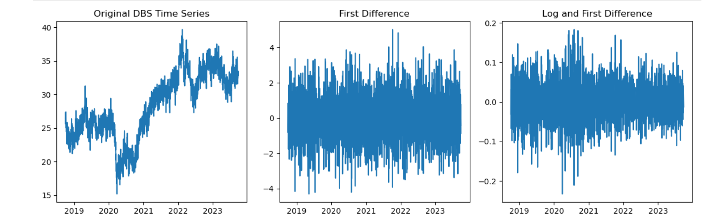
DBS Stock
I then plotted the original time series , the first difference, and the Log and First Difference. The plot before adding White Noise shows that. The dataset before adding white noise looks empty , however, after adding the White Noise, the dataset looks much more heteroskedastic and will be better for the predictive model
Before adding White Noise
After adding White Noise

Slide 18
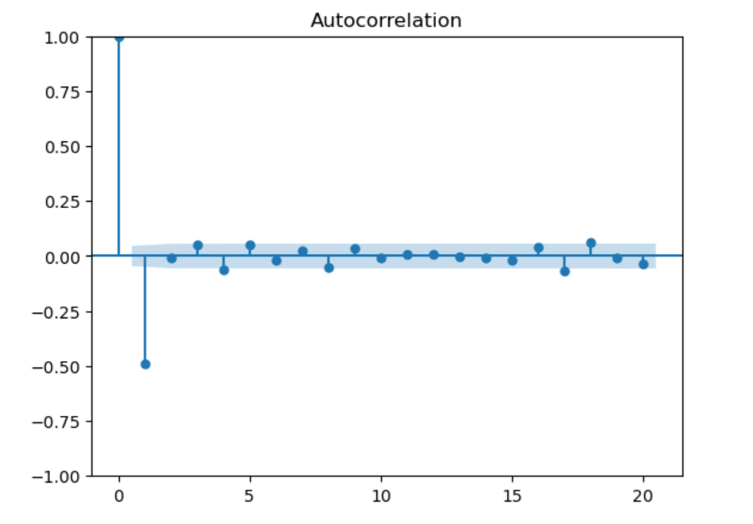
ACF Plot (DBS)
From this plot, we can see that DBS also only has a proper correlation with its past self. The rest of the lags still show little to no correlation, except for at lag 2, where it shows a moderate negative correlation. This could be as DBS might have experience a significant change such as a market-wide event, during that lag.

Slide 19
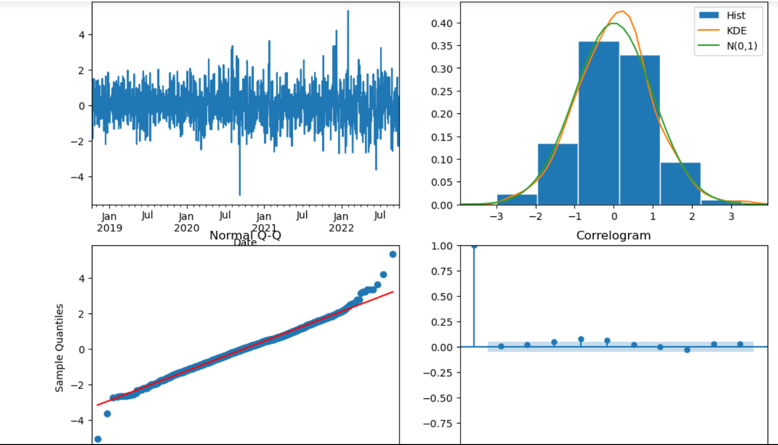
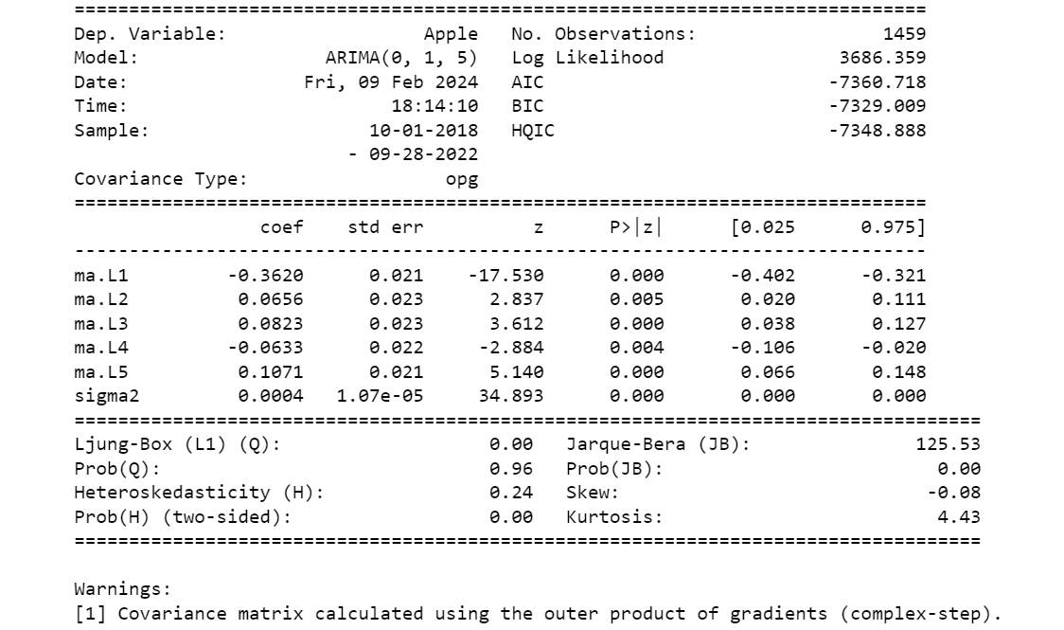
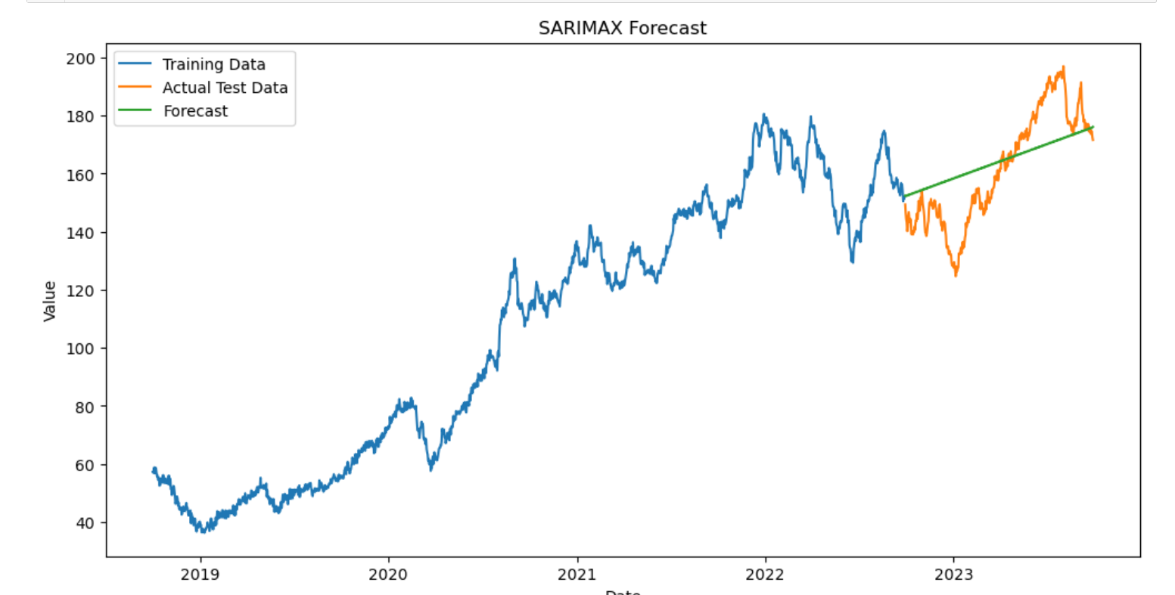
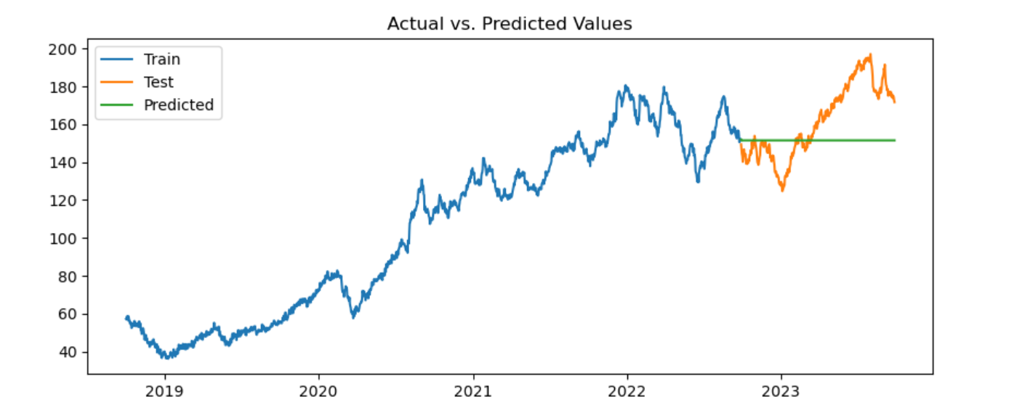
Predictive Model for Apple
ARIMA Model
SARIMAX Model
I used 2 models, Auto ARIMA AND SARIMAX. I used Auto ARIMA solely for comparison while SARIMAX is my actual predictive Model. As can be seen from the graph. ARIMA predicted a horizontal trend. SARIMAX on the other hand, predicted a upwards trend, showing that the stock price for Apple will gradually increase, which proved to be right using the test data

Slide 20
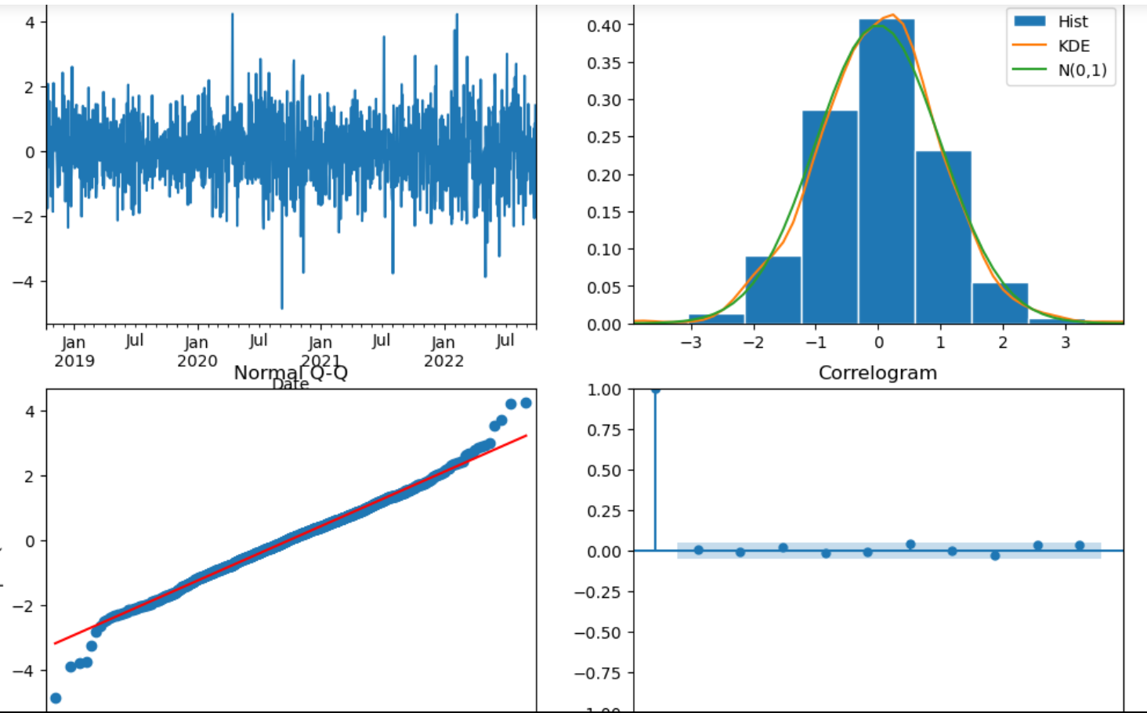
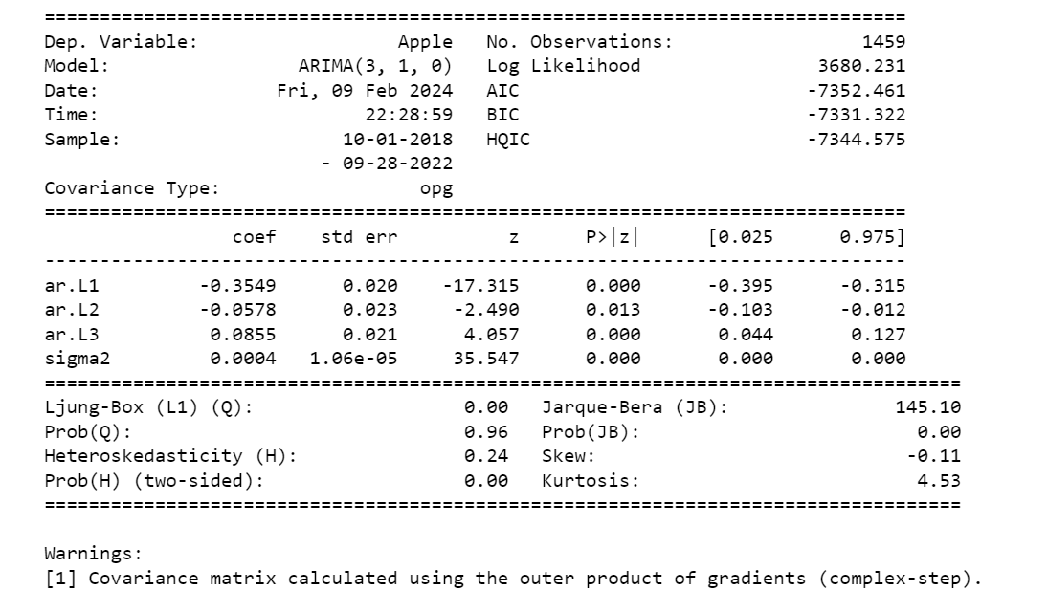
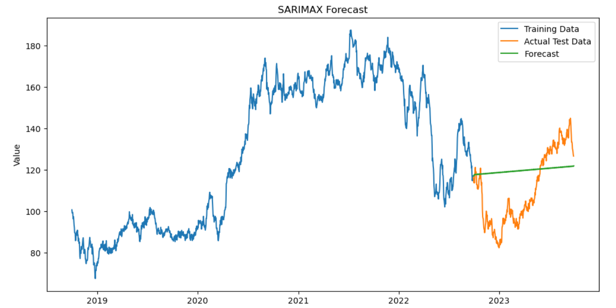
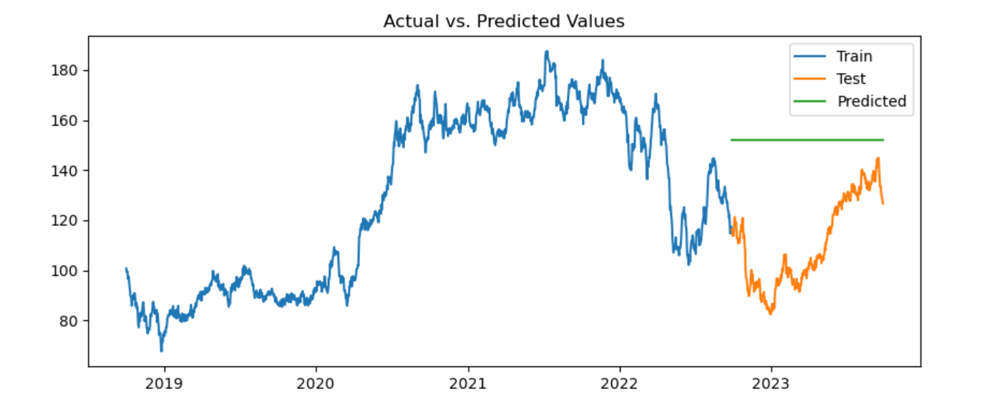
Predictive Model for Amazon
SARIMAX Model
ARIMA Model
From this, as can be seen from the graphs, ARIMA predicted a horizontal trend and did it wrong. SARIMAX on the other hand, predicted a very slight upwards trend, showing that the stock price for Amazon will gradually increase but this will take a long time.

Slide 21
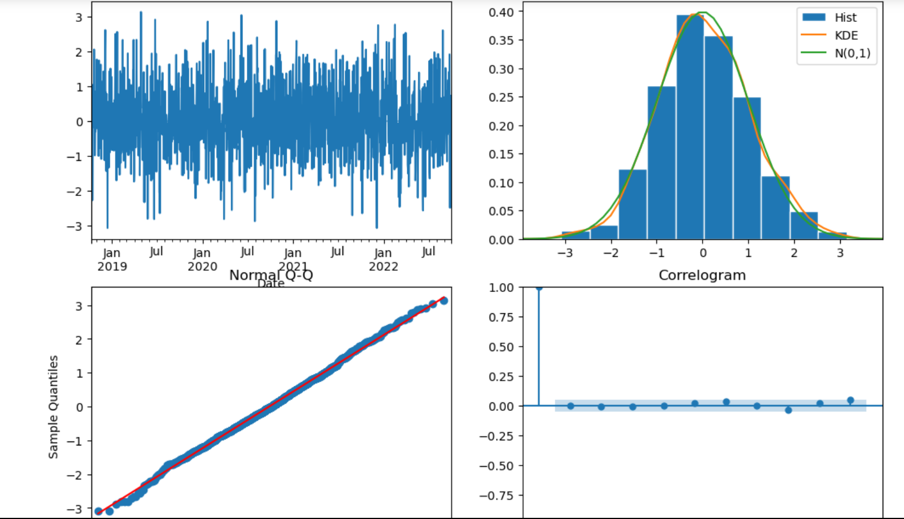
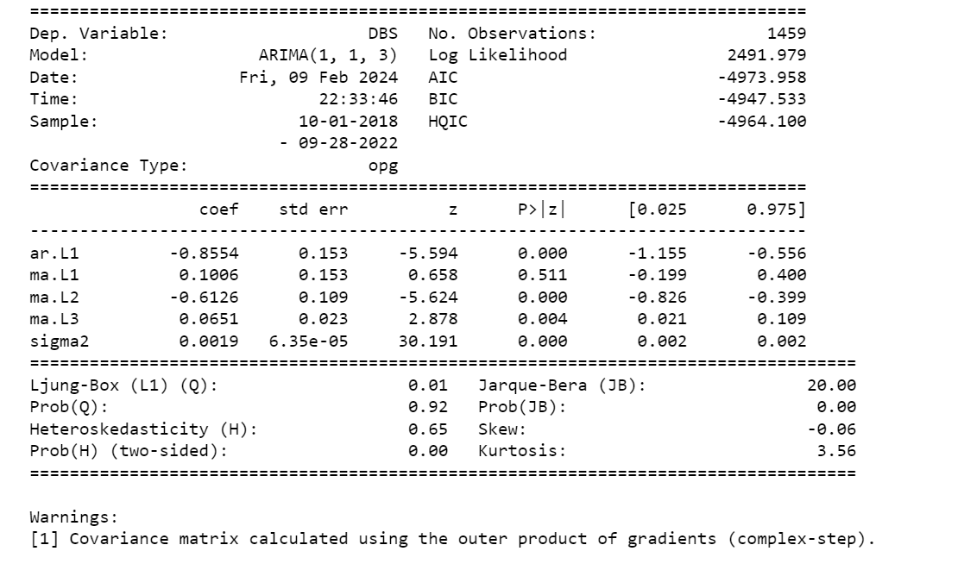
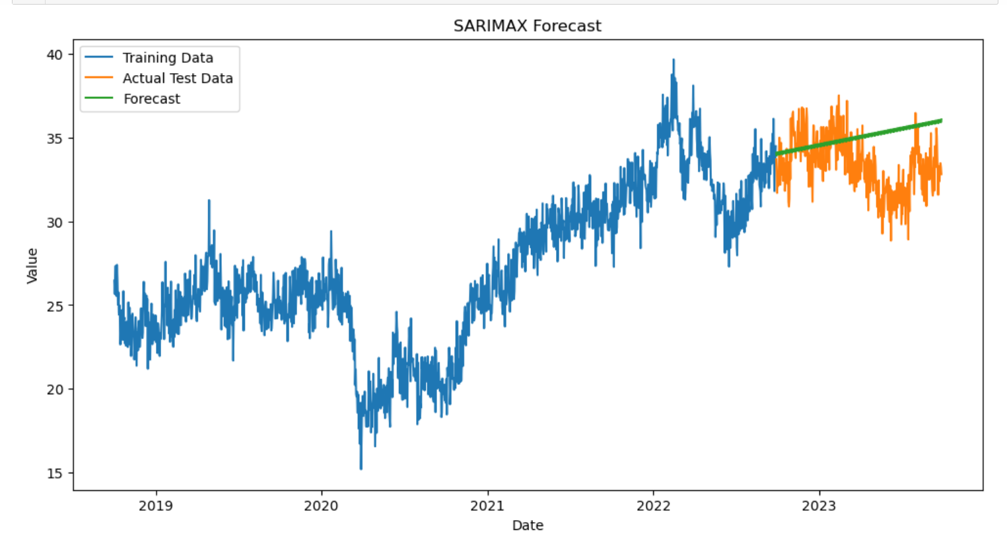
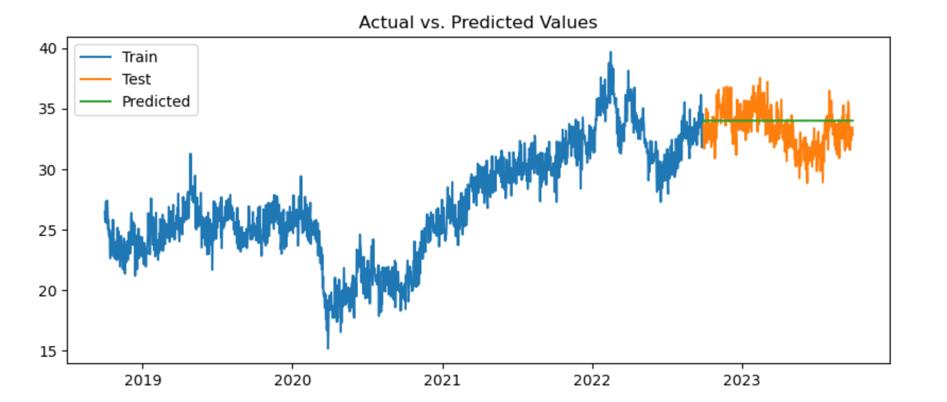
Predictive Model for DBS
SARIMAX Model
ARIMA Model
As for DBS, its shown that ARIMA predicted a horizontal trend. SARIMAX on the other hand, predicted a upwards trend, showing that the stock price for DBS will also gradually increase over the years, as proven by the test data

Slide 22

Final Conclusion
Finally, I can say that after analysing the data, the predictive models show that all 3 stocks will have a gradual increase in their share prices. Moreover, this dataset is one that shows no pattern in any way, making it an accurate dataset for stock prices.

Slide 23
Part B Clustering

Slide 24
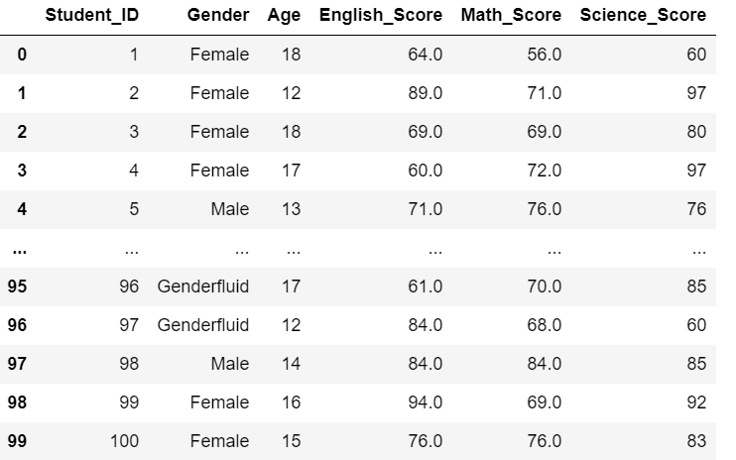
Analysing the Dataset
This dataset shows the test scores of different students based on their genders and Age. I immediately noticed that there were more than just 2 genders. Thus, I decided to see how many there were.

Slide 25
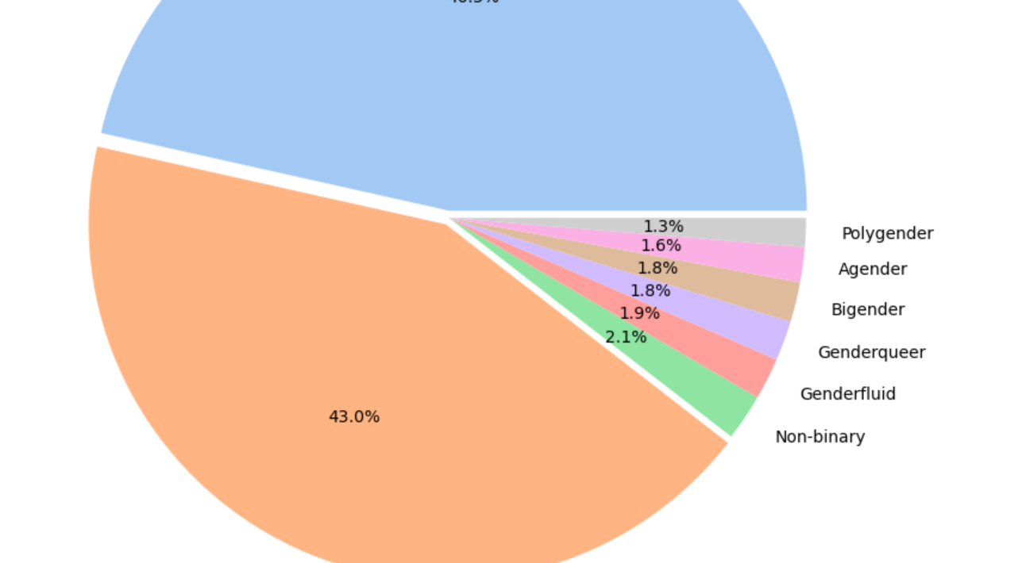
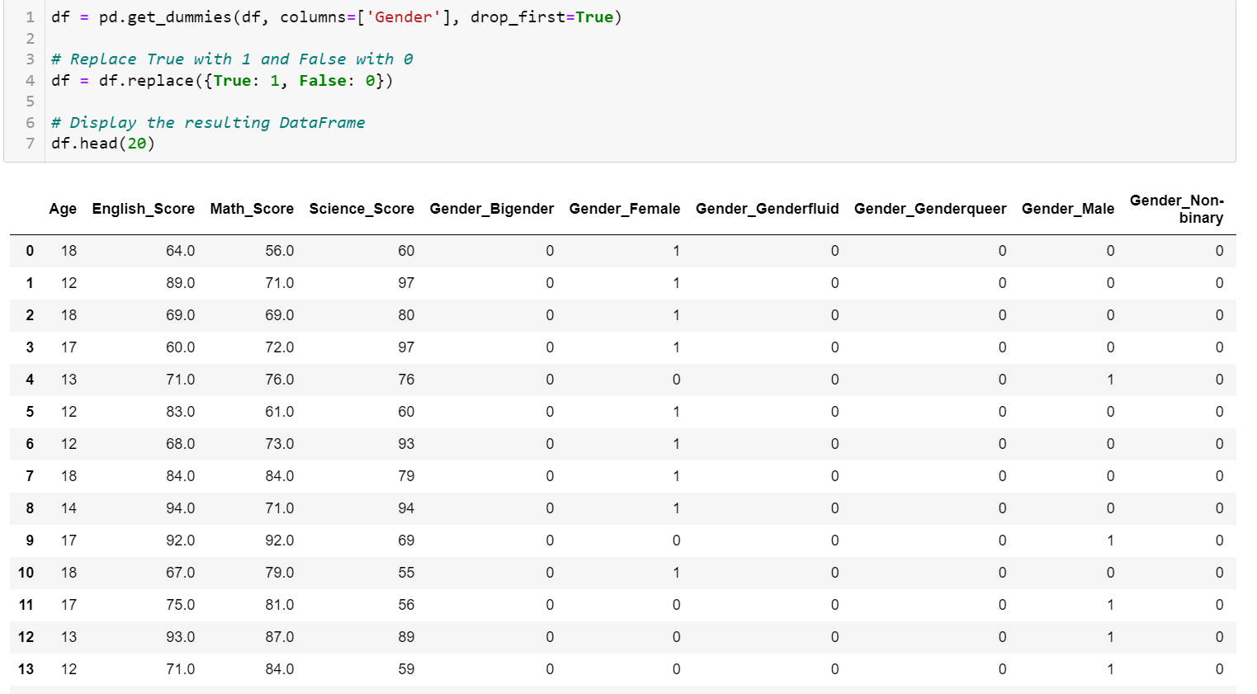
Gender Pie Chart
Using this Pie Chart, I was able to identify that there were more than 2 genders, and there were actually 8 genders. Thus, I used one-hot encoding for all these genders as I felt that they would be crucial for my clustering

Slide 26
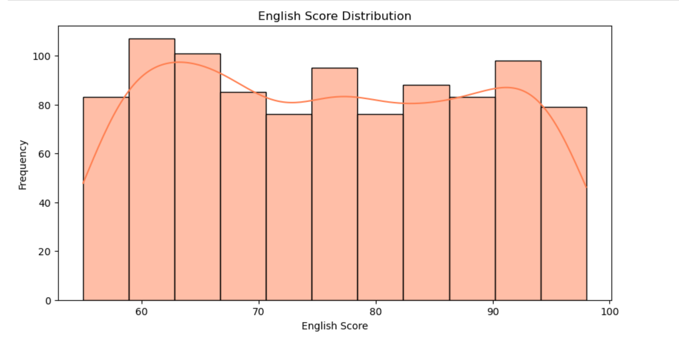
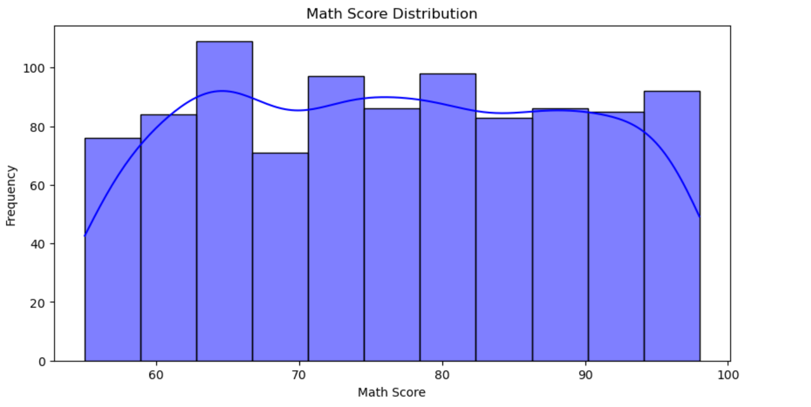
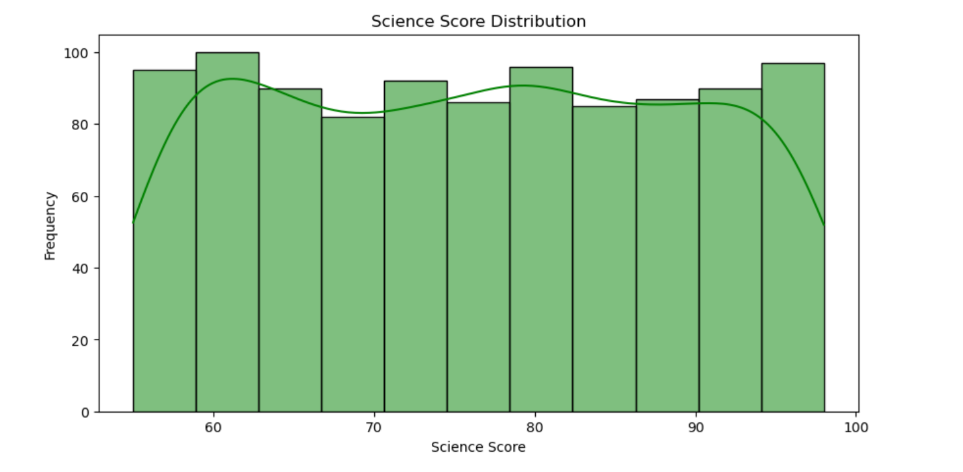
Distribution of Test Scores
I used histograms to view the distribution of the different Subject Test Scores. From this, I was able to see that there is no clear trend in the scores, and the data is somewhat normally distributed for all the subjects.

Slide 27
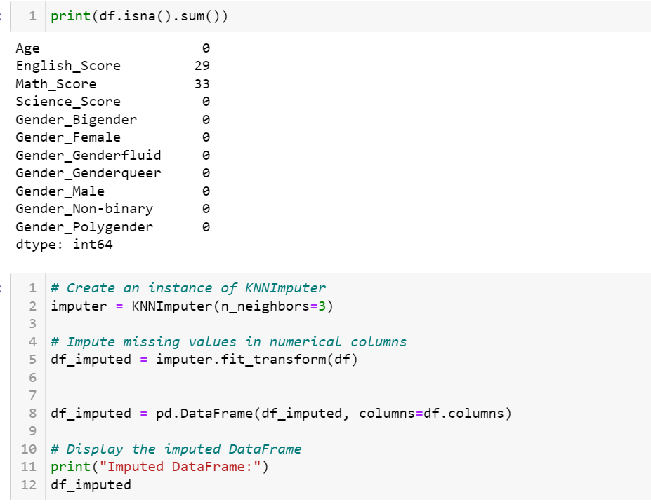
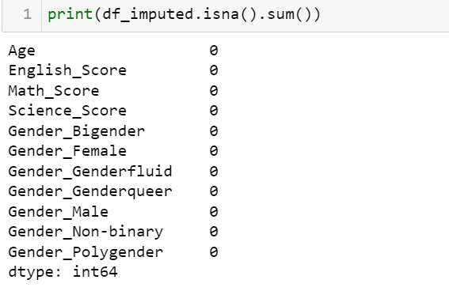
Imputing the Dataset
I then decided to impute the dataset using KNNImputer as I realized that there were some missing values in some of the subject test scores.

Slide 28
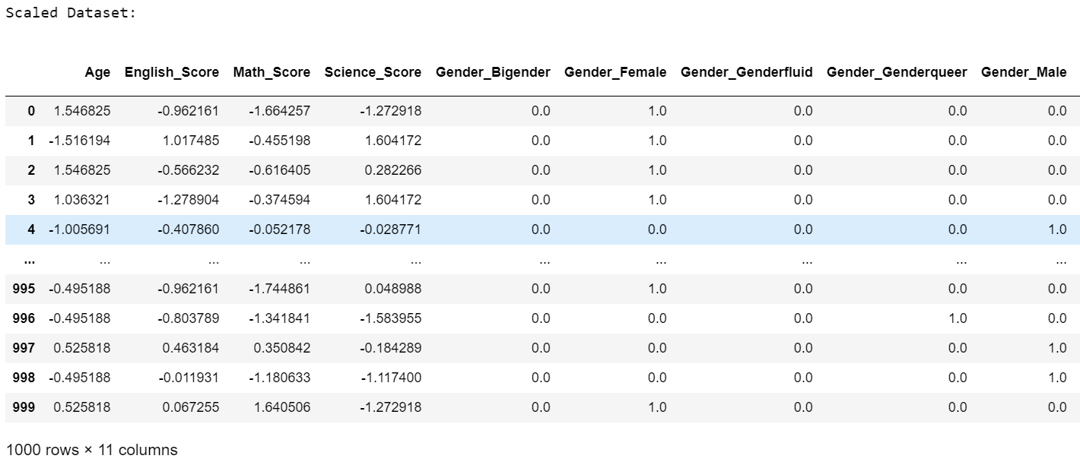
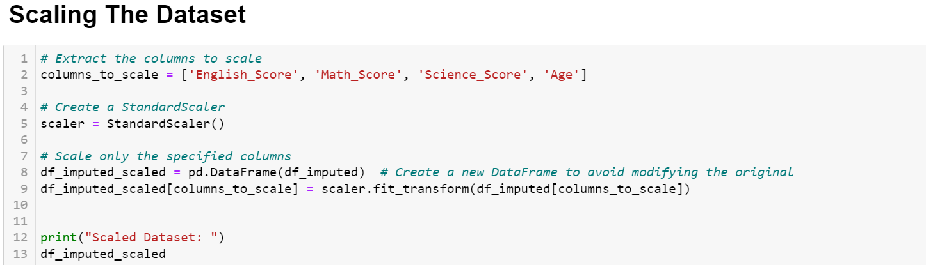
Scaling the Dataset
I also scaled the data using Standard Scaler to make the clusters more defined later on

Slide 29
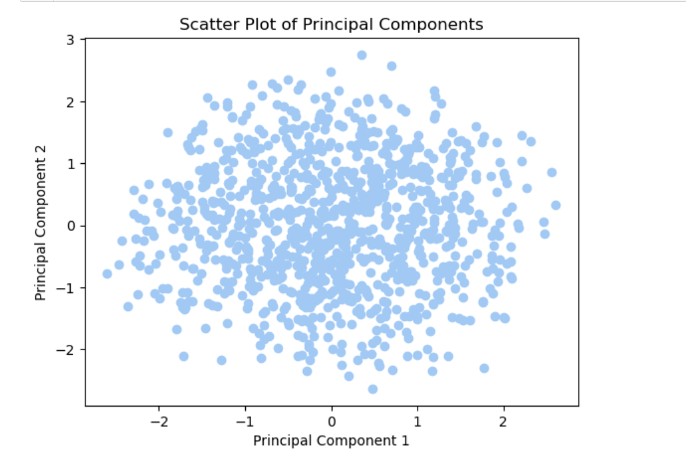

Dimensionality Reduction
After analyzing the scaled dataset, I came to the realization that all the columns were equally important, thus I needed to keep all of it for clustering. However, there were too many columns. So I ended up using PCA in order to identify and put the most important values from the scaled dataset into 2 columns PCA1 and PCA2, making it easier to get a X and Y axis for my clustering.

Slide 30

Finding Inertia for Elbow Method
From this, I realize that we can’t find the best number of clusters using the elbow method as there is no clear elbow pit here, thus making it impossible to determine the best K value

Slide 31

Silhouette Method
Thus, I decided to use the Silhouette Method instead, and from this graph, I was able to identify the peak at 6, thus showing that 6 is the best number of clusters to use

Slide 32


K-Means Clustering
Using K-Means Clustering and the desired number of clusters, I was able to see the clusters clearly. I was also able to generate a silhouette score of 0.35

Slide 33

Silhouette Plot
From this, I can see that the clustering was good and accurate as the silhouette plot is good and the score is also good.

Slide 34


Agglomerative Clustering
I then used agglomerative clustering as well for the dataset. As can be seen from the dendrogram, it shows the different clusters and how they are grouped together. This also showed the relation the clusters had with each other. However, from this, we can see that the silhouette score is low, showing that this clustering method was not as optimal

Slide 35

GMM Clustering
For GMM clustering, We can see that it was also able to cluster the data into 6 different clusters well. However, while the silhouette score for it is good, it isn’t as optimal yet

Slide 36

Spectral Clustering
Lastly, I also used Spectral Clustering as a final model. From the scatterplot, we can see that it was also able to group the data into different clusters well. However, its silhouette score is also not as good as compared to K-Means Clustering

Slide 37
Final Conclusion
Thus, After Imputing and Scaling the Dataset, I can come to the final conclusion that for this dataset, K-Means clustering proved to be the best model in properly grouping the dataset into the best number of clusters ( n = 6) as shown by the Silhouette Model.

Slide 38
THANK YOU

